Slide 1

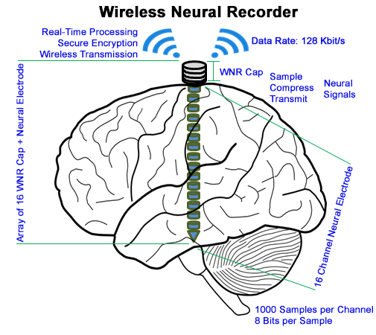
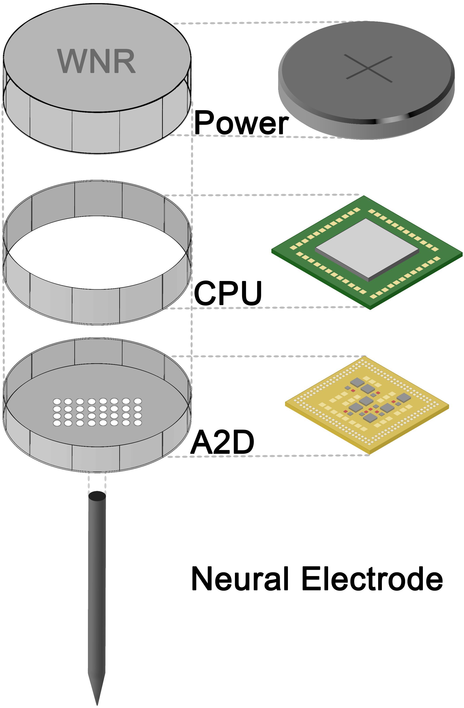
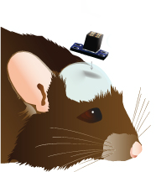
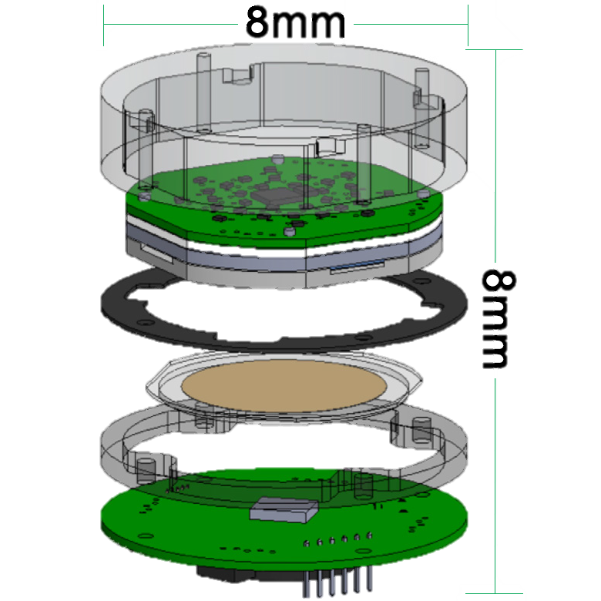



Energy-Efficient High-Throughput Wireless Transmission of Multi-Channel Neural Signals
Wireless Neural Recorder - Senior Design Team
Yuan Gao, Xin Huang, Tingkai Liu, Stephen Xia
Department of Electrical and Computer Engineering, Rice University
ricewnr@gmail.com
Project Description
Engineering Design for a Single WNR Cap
Problem:
Current Electrocochleography (ECoG) monitoring requires physical cables connected to brain to collect critical data for epilepsy diagnosis
Lack of advanced wirelessly transmitting, implantable, monitoring devices hinder scientific progress and affect patient quality of life
System Design Goal:
Create a compact, power-efficient, high-fidelity add-on cap to ECoG electrodes to wirelessly transmit neural data securely in real-time
Areas of Impact:
Neurosurgeons & Hospitals – Simpler procedure and data monitoring
Scientists & Research Institutions – Brain Machine Interface R&D
Epilepsy Patients & their Families – Mobility and QOL improvement
Neural Data
A2D Converter
ARM Microprocessor
Bluetooth Low Energy
Recording Server
System Design Specifications
Neural Electrode
16 Data Channels
1K Samples/sec
8 Bits/Sample
Data: 128 Kbit/s
Intan RHD2132
Specialized Neural Recording with Protective Circuitry
NanoVolt Data Sampling Precision
Nordic NRF52
Powerful ARM Cortex-M4 Processor
Data Buffering and Compression
Nordic NRF52
128 bit AES Encryption
1 Mbit/s Bandwidth
< 6mA Power Consumption
Mobile Device
Communicates with all WNR Caps
Real-time Neural Data Collection and Presentation
WNR System
Conclusion
Achieved goal of creating a compact, power-efficient, and precise Wireless Neural Recorder (WNR) and transmitter system, allowing neurosurgeons to obtain data while giving patients the freedom to move freely without being wired to a hospital bed
Transmission:
1 Mbit/s Bandwidth
0.27 Mbit/s Throughput
Data:
Available 32 Channel Sampling
1000 Samples per Second
8 Bit Data Precision
Power:
Ultra-Low Power Consumption
12 Hour Battery Life
75mAh Off-the-Shelf Battery
Size & Safety:
PCB size of 12x14 mm
Integrated Protective Circuitry
First generation system, with off-the-shelf components, achieves 50% data compression with sufficient excess compute power to integrate new software features such as epilepsy detection
Next Steps
Small animal testing and data collection with functional prototype
Fabrication of custom components for smaller
8 x 8 x 8 mm design
Utilize new WiFi HaLow for increased bandwidth, data rate, and data fidelity
Expand WNR device to diagnose and monitor other diseases of the brain
Design Requirements
Criteria | Target Value | Result
Data Channels | 16 Channels
Data Precision | 8 Bits
Sampling Frequency | 1000 Samples per Second
Form Factor | 15 x 15 x 15 mm
Battery Life | 12 Hours
Acknowledgements
We would like to thank Rice ECE department members: Dr. Gary Woods, Dr. Aydin Babakhani, Hamed Rahmani and UTHealth Neurosurgeon: Dr. Nitin Tandon, for their technical advice and project support.
Special thanks to the Brenner Foundation with Ellen Kirk and the resources of the Oshman Engineering Design Kitchen.

